Slide 1

Chapter 25
Multimedia
Objectives
Upon completion you will be able to:
Know the characteristics of the 3 types of services
Understand the methods of digitizing and compressing.
Understand jitter, translation, and mixing in real-time traffic
Understand the role of RTP and RTCP in real-time traffic
Understand how the Internet can be used as a telephone network

Slide 2
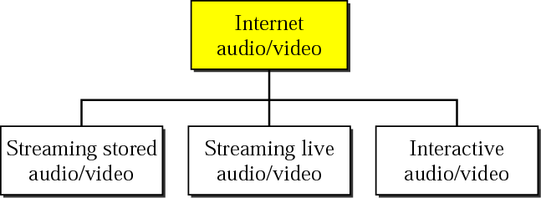
Figure 25.1 Internet audio/video

Slide 3

Note:
Streaming stored audio/video refers to on-demand requests for compressed
audio/video files.

Slide 4
Note:
Streaming live audio/video refers to the broadcasting of radio and TV programs through the Internet.

Slide 5
Note:
Interactive audio/video refers to the use of the Internet for interactive audio/video applications.

Slide 6
25.1 DIGITIZING AUDIO AND VIDEO
Before audio or video signals can be sent on the Internet, they need to be digitized. We discuss audio and video separately.
The topics discussed in this section include:
Digitizing Audio
Digitizing Video

Slide 7
Note:
Compression is needed to send video over the Internet.

Slide 8
25.2 AUDIO AND VIDEO
COMPRESSION
To send audio or video over the Internet requires compression.
The topics discussed in this section include:
Audio Compression
Video Compression

Slide 9
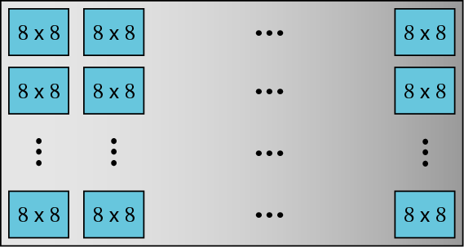
Figure 25.2 JPEG gray scale

Slide 10
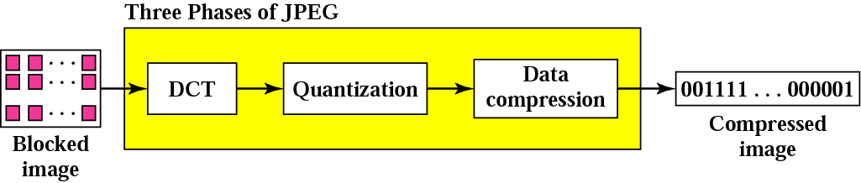
Figure 25.3 JPEG process

Slide 11
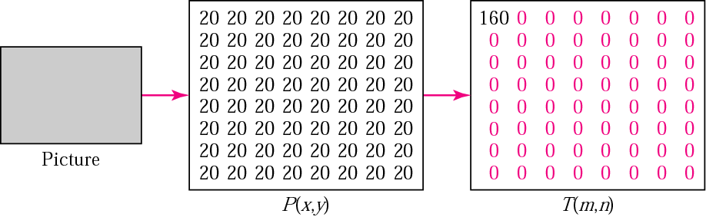
Figure 25.4 Case 1: uniform gray scale

Slide 12
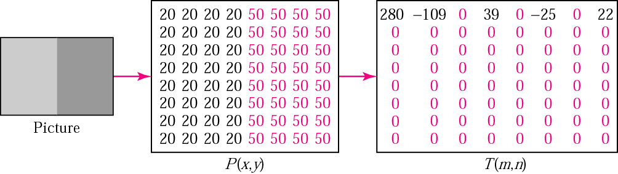
Figure 25.5 Case 2: two sections

Slide 13
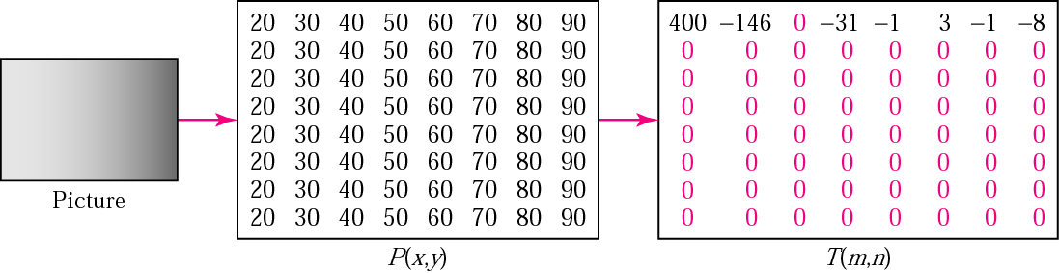
Figure 25.6 Case 3: gradient gray scale

Slide 14
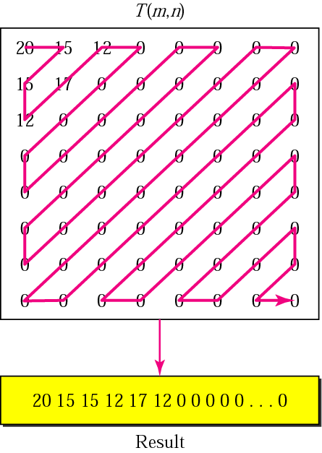
Figure 25.7 Reading the table

Slide 15

Figure 25.8 MPEG frames

Slide 16
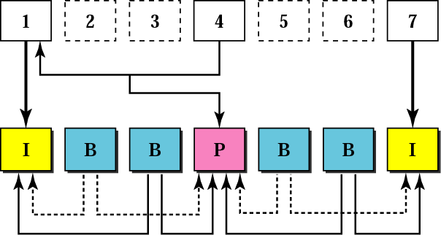
Figure 25.9 MPEG frame construction

Slide 17
25.3 STREAMING STORED
AUDIO/VIDEO
We turn our attention to a specific applications called streaming stored audio and video. We use four approaches to show how a file can be downloaded, each with a different complexity.
The topics discussed in this section include:
First Approach: Using a Web Server
Second Approach: Using a Web Server with Metafile
Third Approach: Using a Media Server
Fourth Approach: Using a Media Server and RTSP

Slide 18
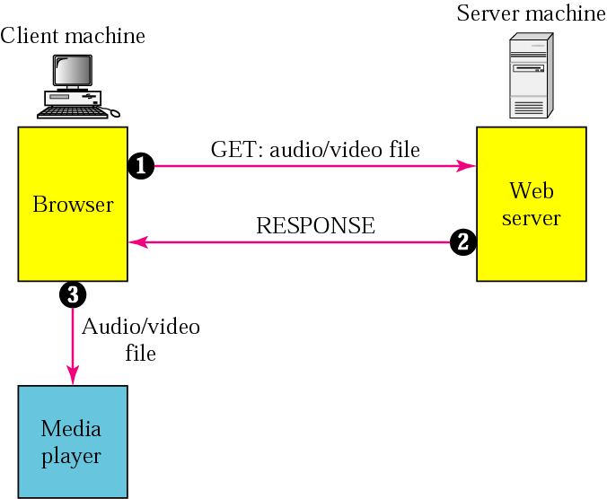
Figure 25.10 Using a Web server

Slide 19
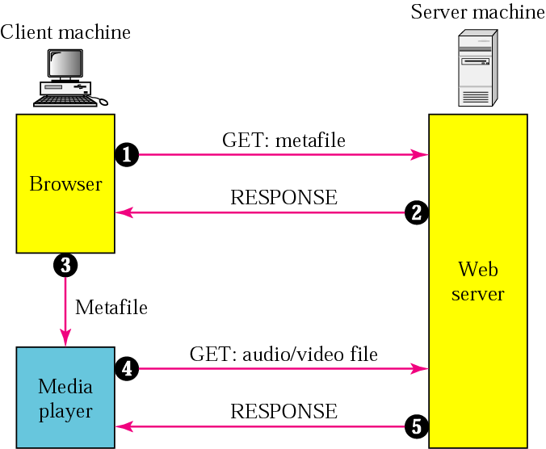
Figure 25.11 Using a Web server with a metafile

Slide 20
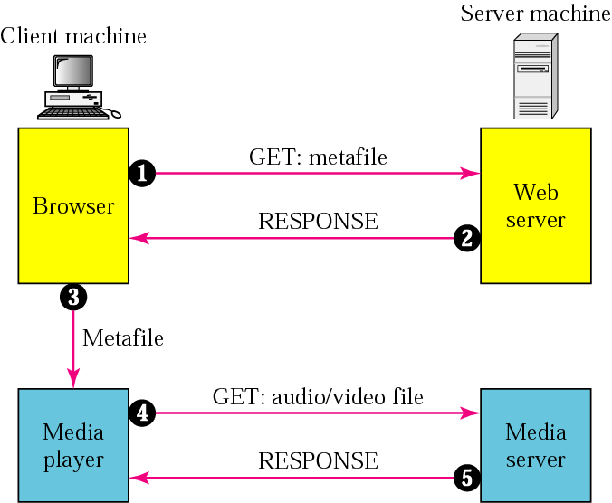
Figure 25.12 Using a media server

Slide 21
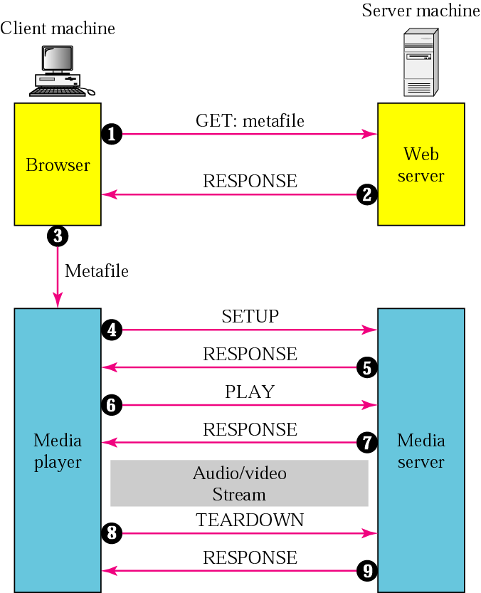
Figure 25.13 Using a media server and RTSP

Slide 22
25.4 STREAMING LIVE
AUDIO/VIDEO
In streaming live audio/video the stations broadcast through the Internet. Communication is multicast and live. Live streaming is better suited to the multicast services of IP and the use of protocols such as UDP and RTP.

Slide 23
25.5 REAL-TIME INTERACTIVE
AUDIO/VIDEO
In real-time interactive audio/video, people communicate visually and orally with one another in real time. Examples include video conferencing and the Internet phone or voice over IP.
The topics discussed in this section include:
Characteristics

Slide 24
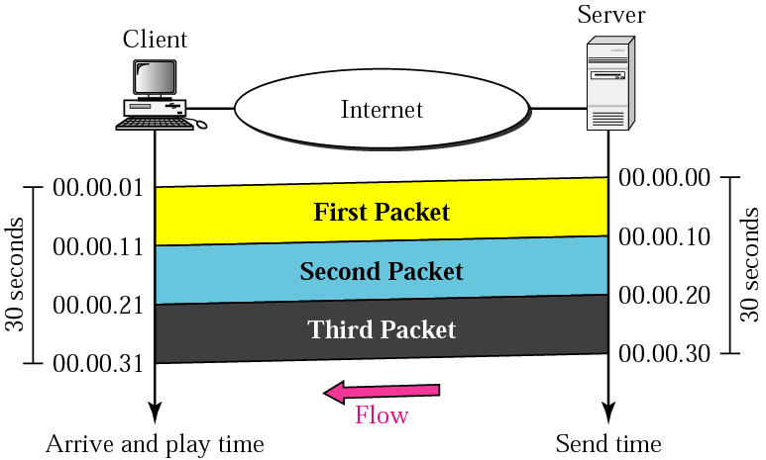
Figure 25.14 Time relationship

Slide 25
Note:
Jitter is introduced in real-time data by the delay between packets.

Slide 26
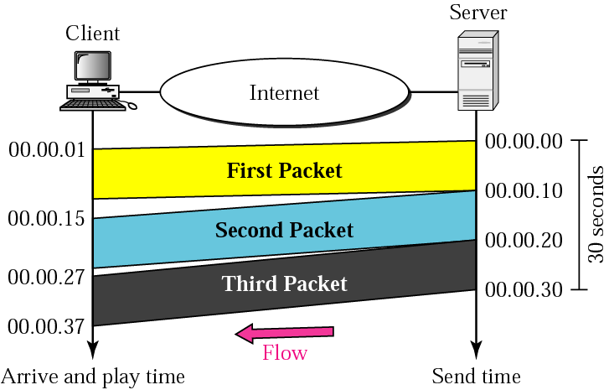
Figure 25.15 Jitter

Slide 27
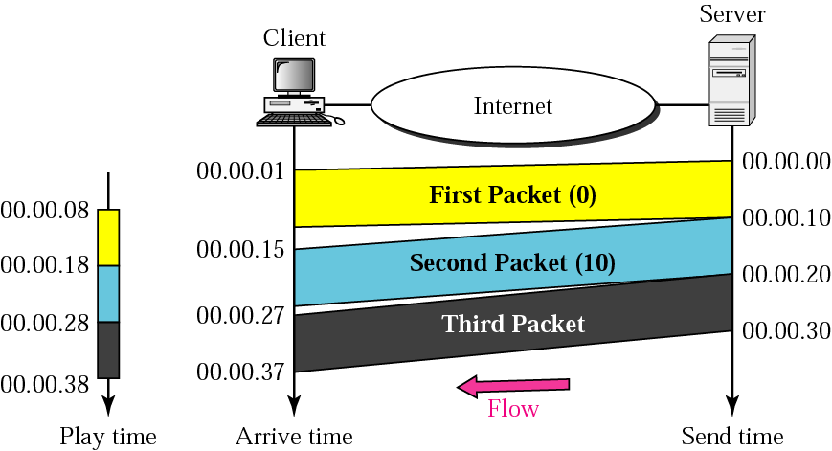
Figure 25.16 Timestamp

Slide 28
Note:
To prevent jitter, we can timestamp the packets and separate the arrival time from the playback time.

Slide 29
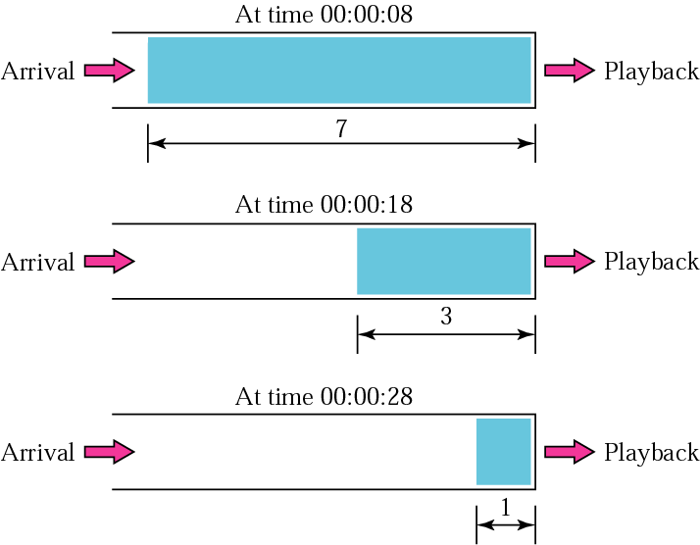
Figure 25.17 Playback buffer

Slide 30
Note:
A playback buffer is required for
real-time traffic.

Slide 31
Note:
A sequence number on each packet is required for real-time traffic.

Slide 32
Note:
Real-time traffic needs the support of multicasting.

Slide 33
Note:
Translation means changing the encoding of a payload to a lower quality to match the bandwidth
of the receiving network.

Slide 34
Note:
Mixing means combining several streams of traffic into one stream.

Slide 35
Note:
TCP, with all its sophistication, is not suitable for interactive multimedia traffic because we cannot allow retransmission of packets.

Slide 36
Note:
UDP is more suitable than TCP for interactive traffic. However, we need the services of RTP, another transport layer protocol, to make up for the deficiencies of UDP.

Slide 37
25.6 RTP
Real-time Transport Protocol (RTP) is the protocol designed to handle real-time traffic on the Internet. RTP does not have a delivery mechanism; it must be used with UDP.
The topics discussed in this section include:
RTP Packet Format
UDP Port

Slide 38
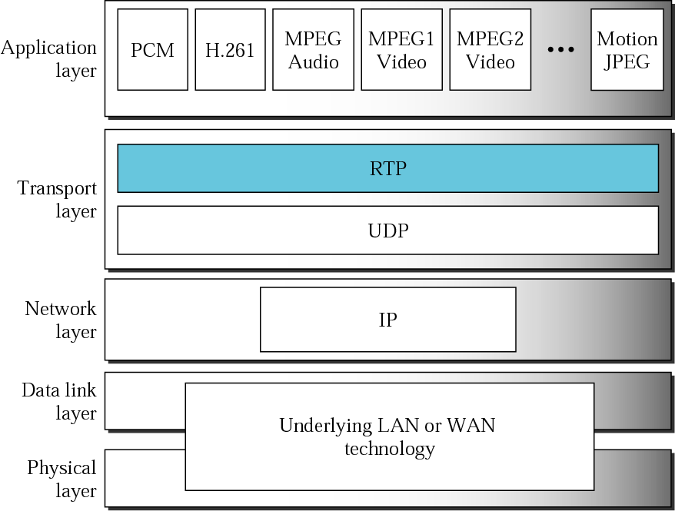
Figure 25.18 RTP

Slide 39
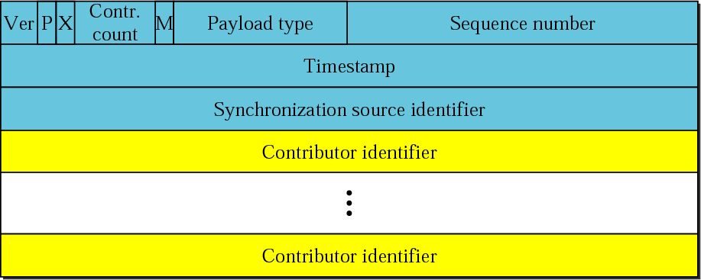
Figure 25.19 RTP packet header format

Slide 40
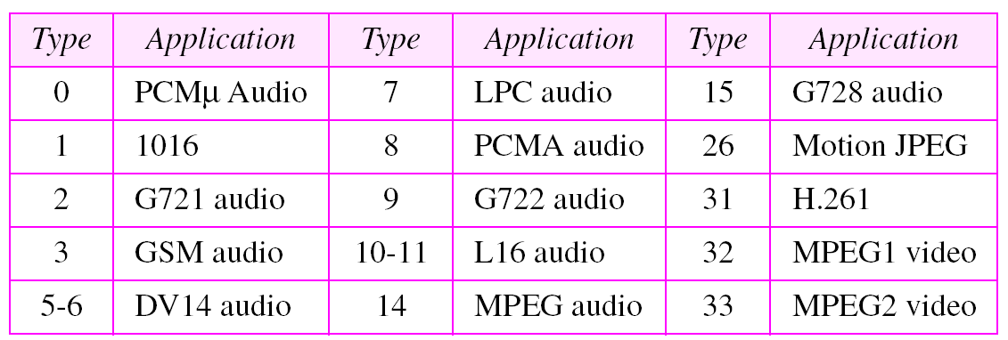
Table 25.1 Payload types

Slide 41
Note:
RTP uses a temporary even-numbered UDP port.

Slide 42
25.7 RTCP
Real-time Transport Control Protocol (RTCP) is a protocol that allows messages that control the flow and quality of data. RTCP has five types of messages.
The topics discussed in this section include:
Sender Report
Receiver Report
Source Description Message
Bye Message
Application Specific Message
UDP Port

Slide 43
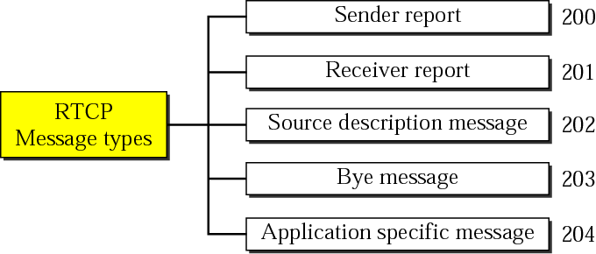
Figure 25.20 RTCP message types

Slide 44
Note:
RTCP uses an odd-numbered UDP port number that follows the port number selected for RTP.

Slide 45
25.8 VOICE OVER IP
Voice over IP, or Internet telephony is an application that allows communication between two parties over the packet-switched Internet. Two protocols have been designed to handle this type of communication: SIP and H.323.
The topics discussed in this section include:
SIP
H.323

Slide 46
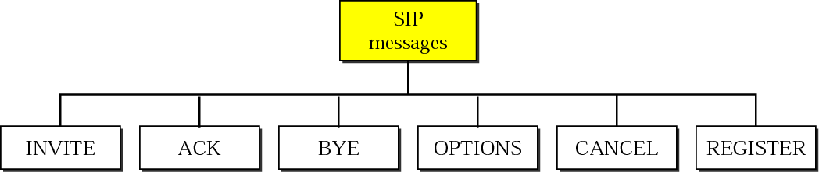
Figure 25.21 SIP messages

Slide 47
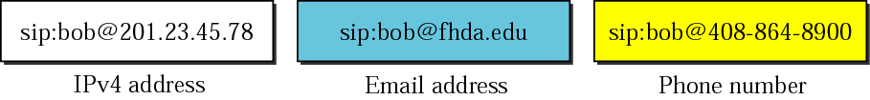
Figure 25.22 SIP formats

Slide 48
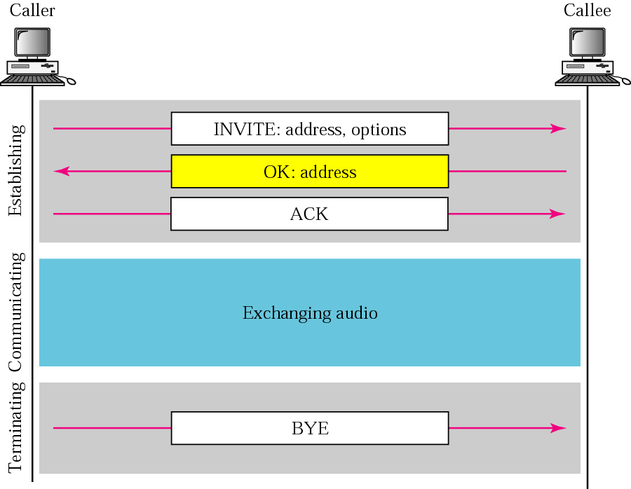
Figure 25.23 SIP simple session

Slide 49
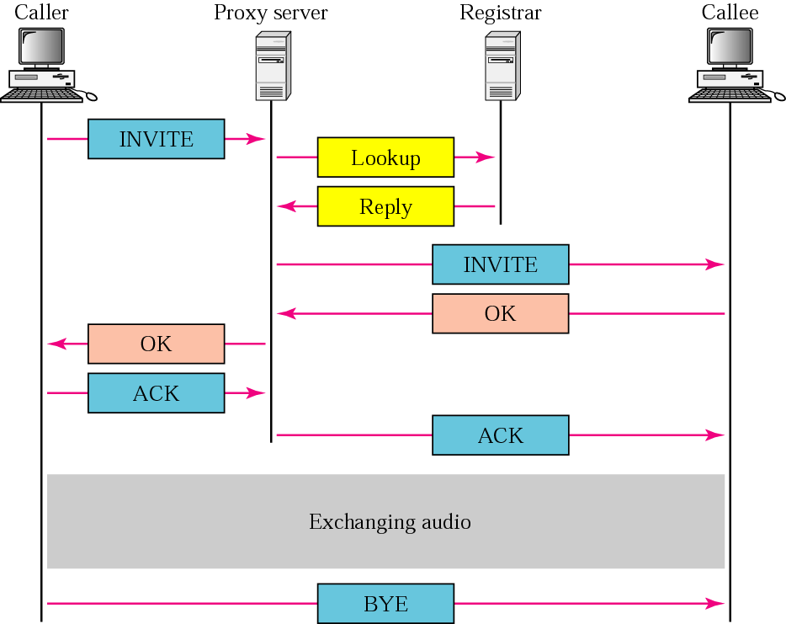
Figure 25.24 Tracking the callee

Slide 50
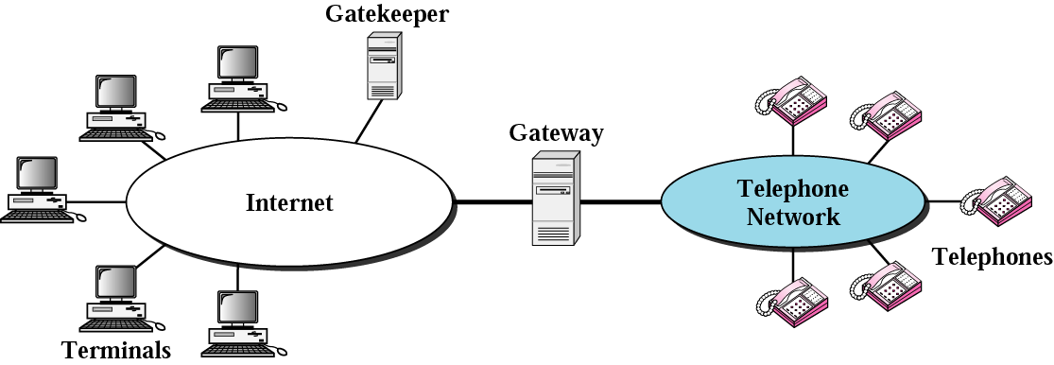
Figure 25.25 H.323 architecture

Slide 51
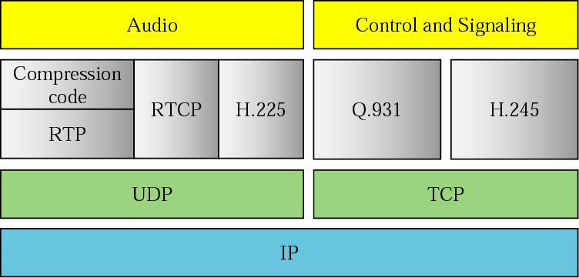
Figure 25.26 H.323 protocols

Slide 52
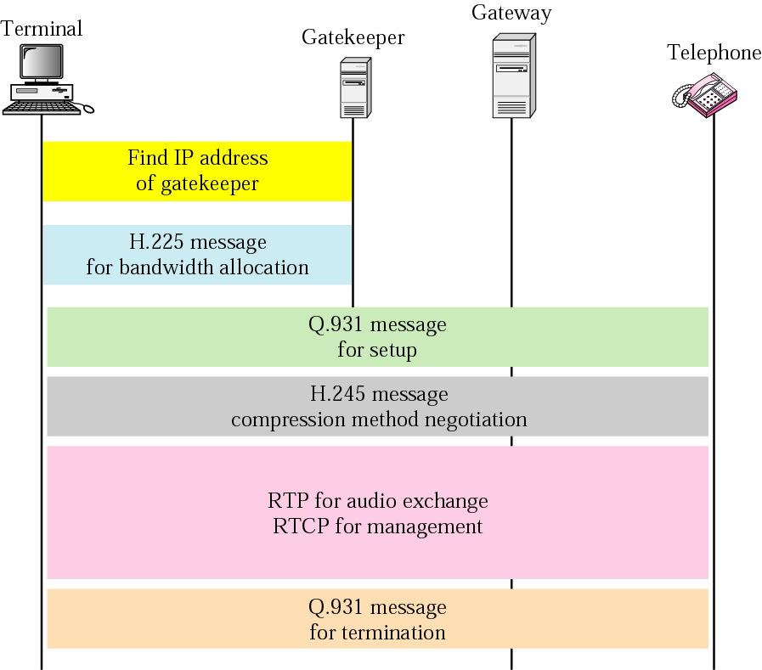
Figure 25.27 H.323 example

